Slide 1
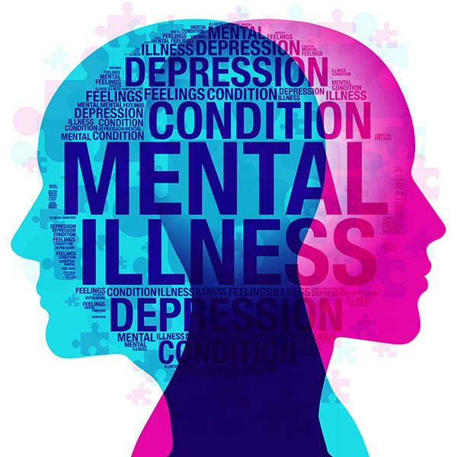

MENTAL AWARENESS
SANJEEV M
2320436

Slide 2
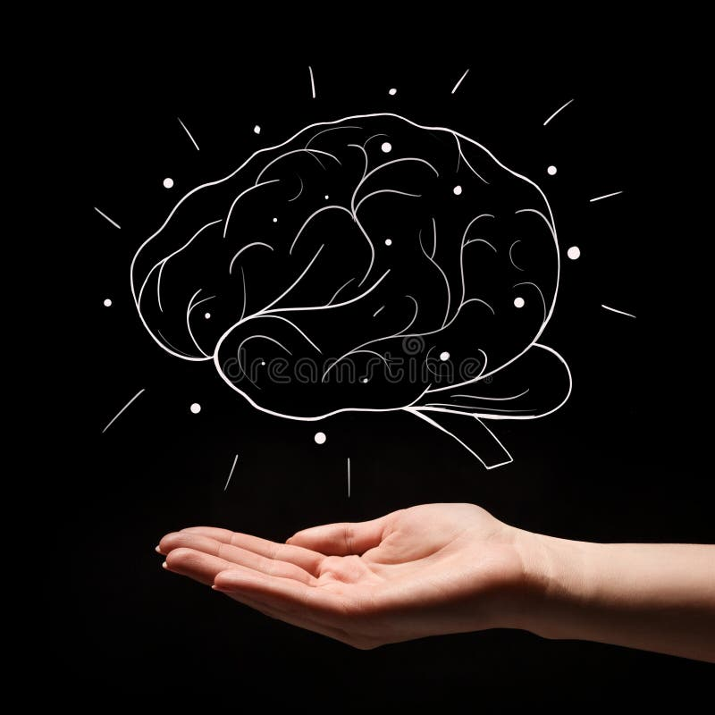
WHAT IS MENTAL HEALTH?
Mental health refers to how we think, feel, and behave
Mental illnesses are disorders, ranging from mild to severe, that affect a person’s thinking, mood, and/or behavior.
According to the National Institute of Mental Health, nearly one-in-five adults live with a mental illness.

Slide 3
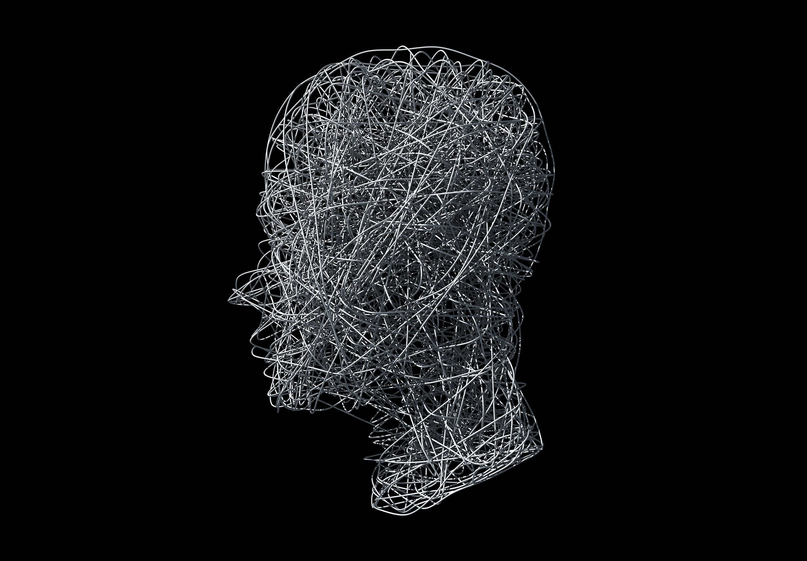
MYTHS
Mental health issues can't affect me
Children don't experience mental health issues
Therapy and self-help are a waste of time.
You can’t prevent mental illness

Slide 4
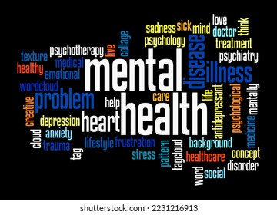
Causes of mental illness
Life Changes
Social Factors
Physical Health
Grief and loss

Slide 5

When the brain is not working properly, one or more of its 6 functions will be disrupted
EMOTION
PERCEPTION
THINKING
SIGNALING
PHYSICAL
BEHAVIOUR

Slide 6
Symptoms
Thinking difficulties or problems focusing attention
Extreme emotional highs and lows
Sleep problems

Slide 7
Examples of Mental Health Conditions
Depression
Bi-polar Disorder
Anxiety
Paranoia
Phobia

Slide 8
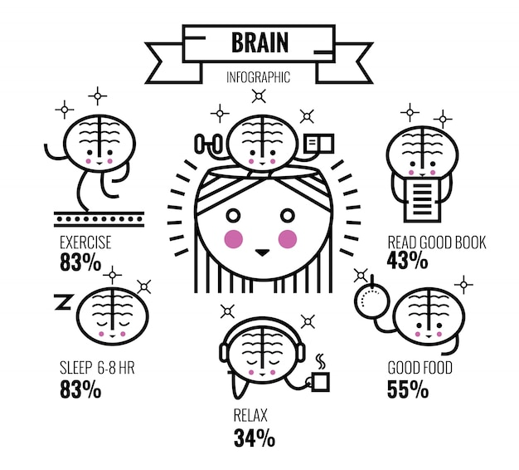
Tips for Living Well with a Mental Health Condition
Practice good self-care
Reach out to family and friends
Get enough sleep
Stick to a treatment plan

Slide 9

Conclusion
Let’s prioritize self-care, seek support when needed, and break the stigma surrounding mental health
Remember, it’s okay not to be okay
Seeking help is a sign of strength, and together, we can foster a world where mental well-being is valued and nurtured

Slide 10

THANK YOU

